Slide 1
Crystal snow ball
Presented by Boyu LIU, Tianci WANG and Rui YAN
For cs148 @Stanford summer 2016

Slide 2
Problem statement
Background
Glass ball
snowflakes
base
desk
In real time!

Slide 3
Source
glew, glfw, glm, No glut!
OpenGL 3.3 core profile
Shader.h, Camera.h from Homework 3
Bitmap.h from https://course.cs.ust.hk/comp5421/Password_Only/projects/impressionist/index.html…

Slide 4
Demo

Slide 5
Different movement mode
We have three movement mode:
Press 1 – move randomly
Press 2 – fall down with gravity without rolling on the ground
Press 3 – fall down with gravity with wind from the bottom of the sphere

Slide 6
Algorithm/Steps
Setup skybox
Use small triangles to build a huge sphere

Slide 7
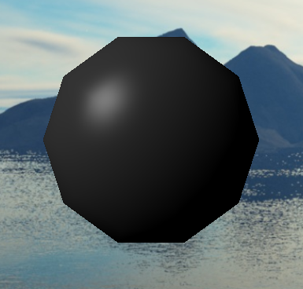
Sphere with 200 triangles

Slide 8
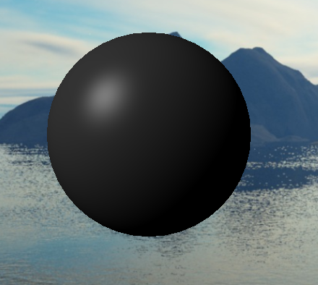
Sphere with 3200 triangles

Slide 9
Algorithm/Steps
Setup skybox
Use small triangles to build a huge sphere
Add refraction and reflection to the sphere

Slide 10
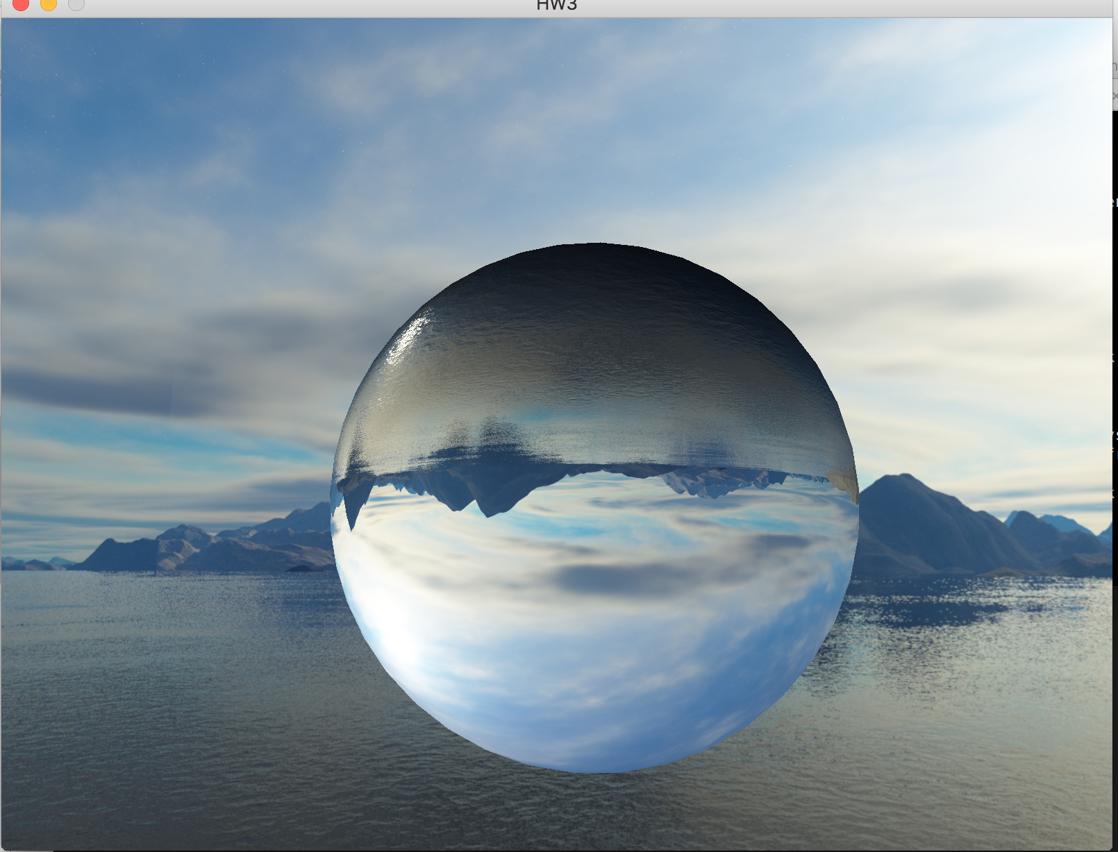
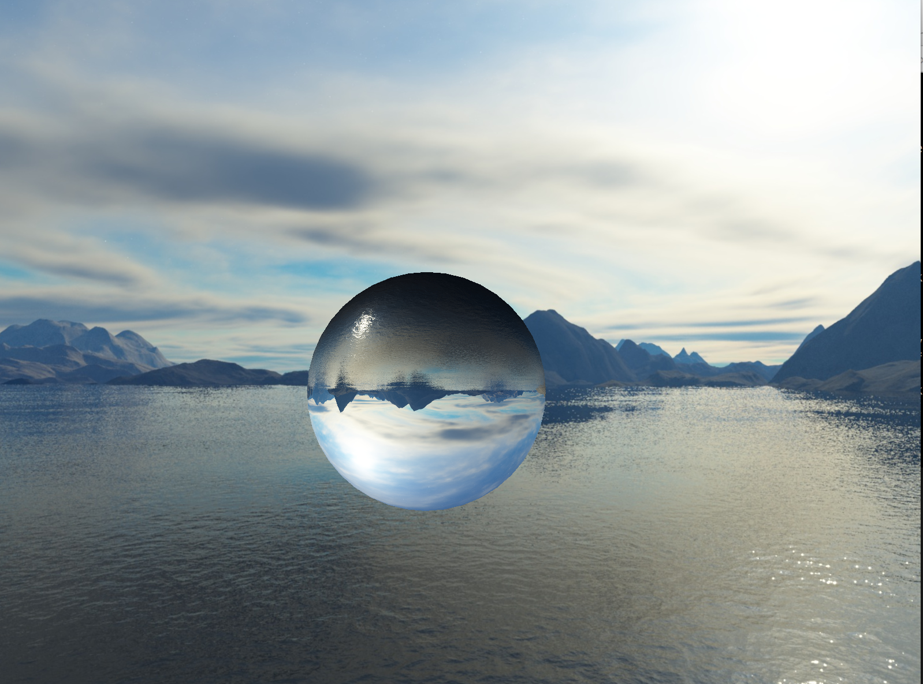
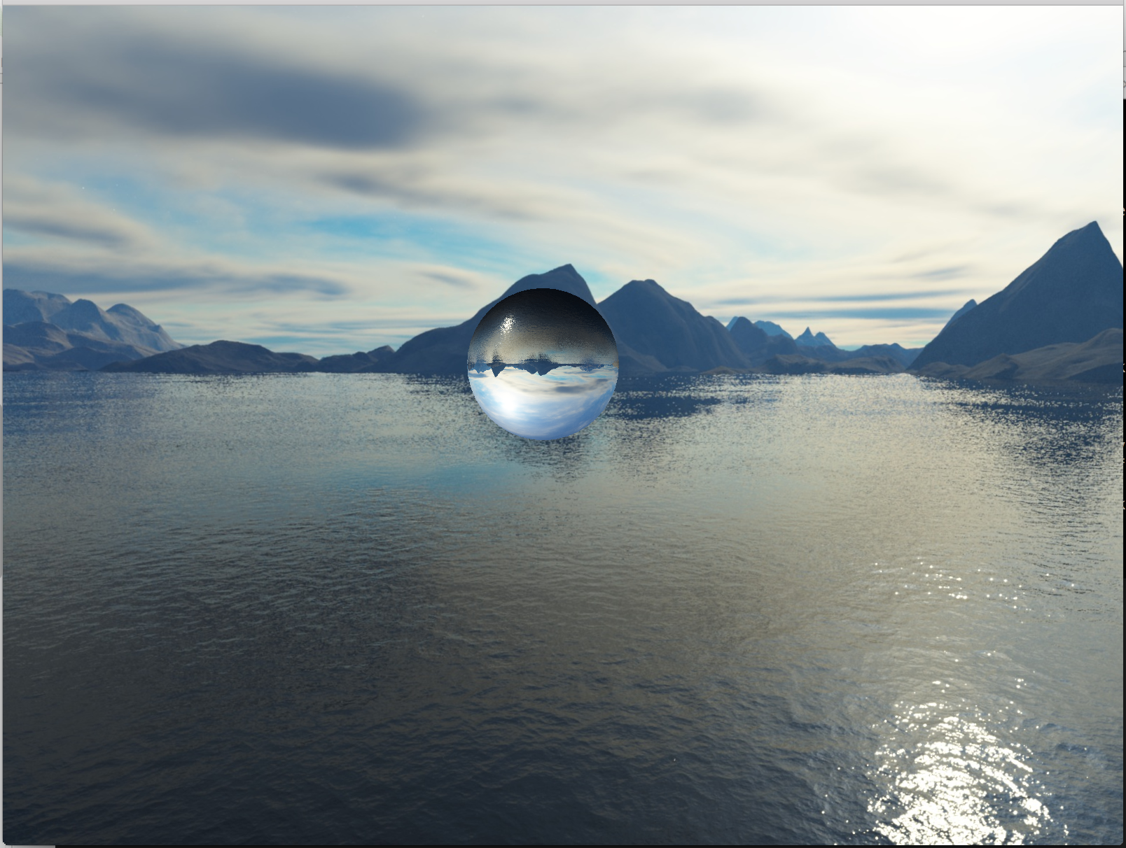
Problem?
Need Glass-like material
Original way of simple environment mapping provides ‘static’ refraction, and no reflection.

Slide 11
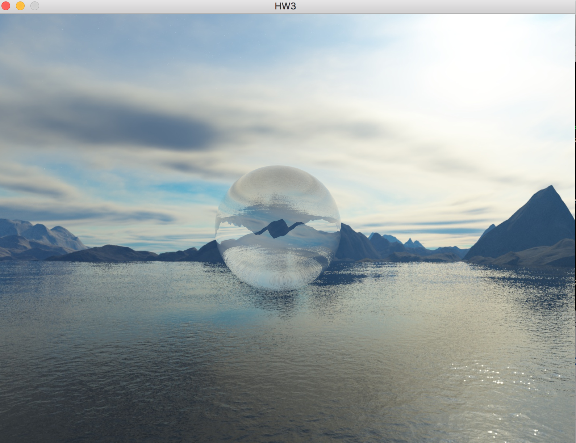
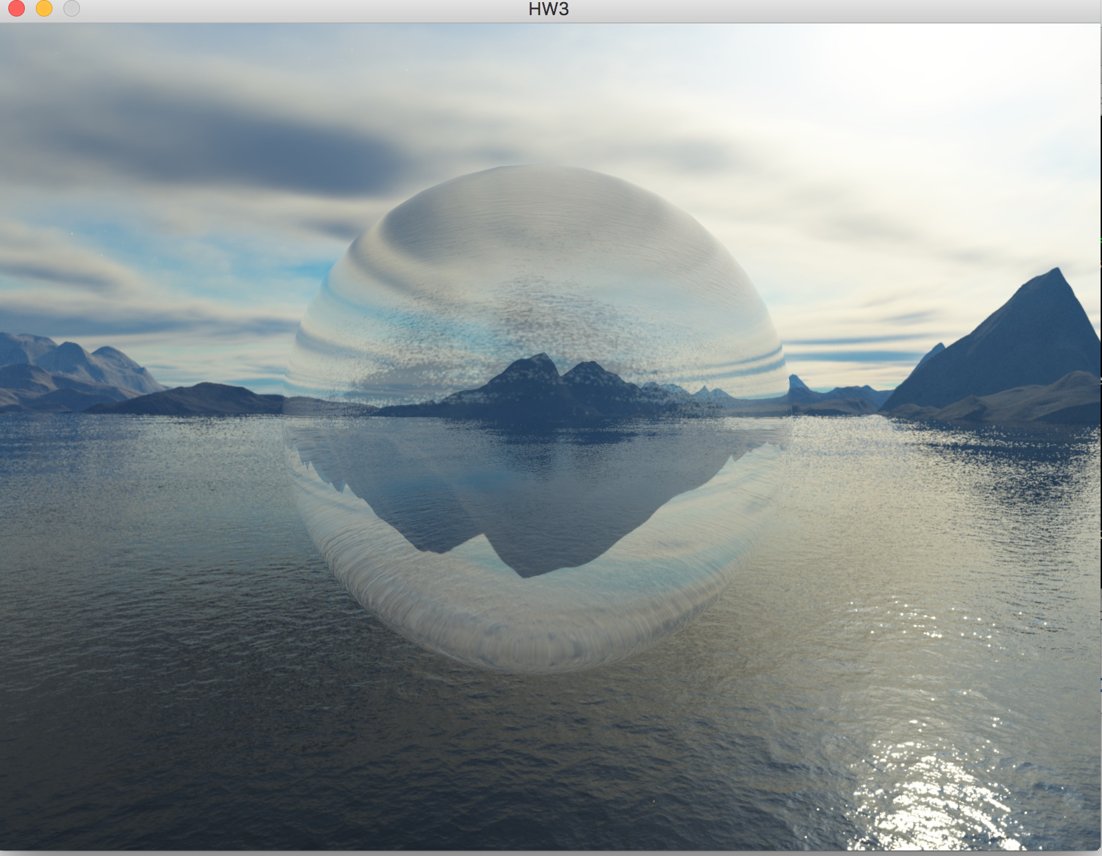
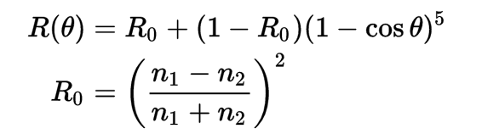
Solution!
Fresnel reflection
Schlick's approximation
Chromatic Aberration

Slide 12
Algorithm/Steps
Setup skybox
Use small triangles to build a huge sphere
Add refraction and reflection to the sphere
Draw snowflake and simulation different mode of movement
Set base

Slide 13
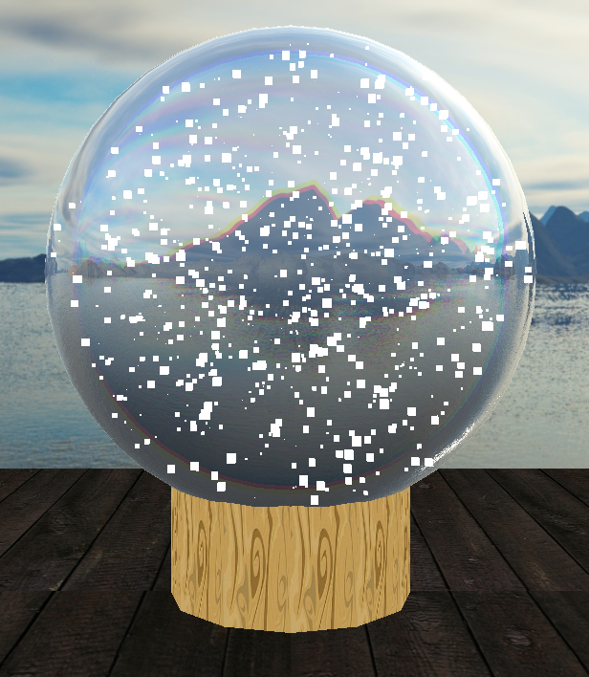
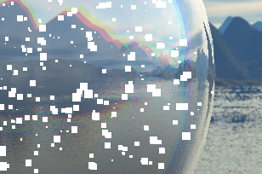
Use small cubes
Simulate snowflakes
Use small cubes

Slide 14
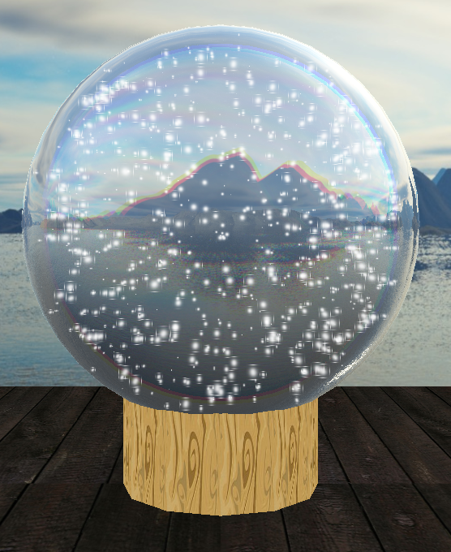
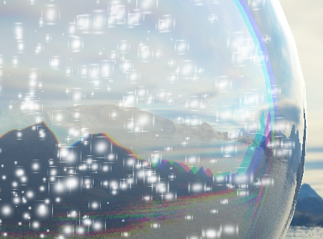
Improvement
Simulate snowflakes
Use small cubes
Use alpha blend to emphasize the area in the middle

Slide 15
Problem?
Order of layout..
The floor should be on top of snowflakes and crystal ball when look from the bottom.
The ball can’t be covered by the snowflakes.
Clear depth buffer?
Depth mask?
Disable Depth test?
….

Slide 16
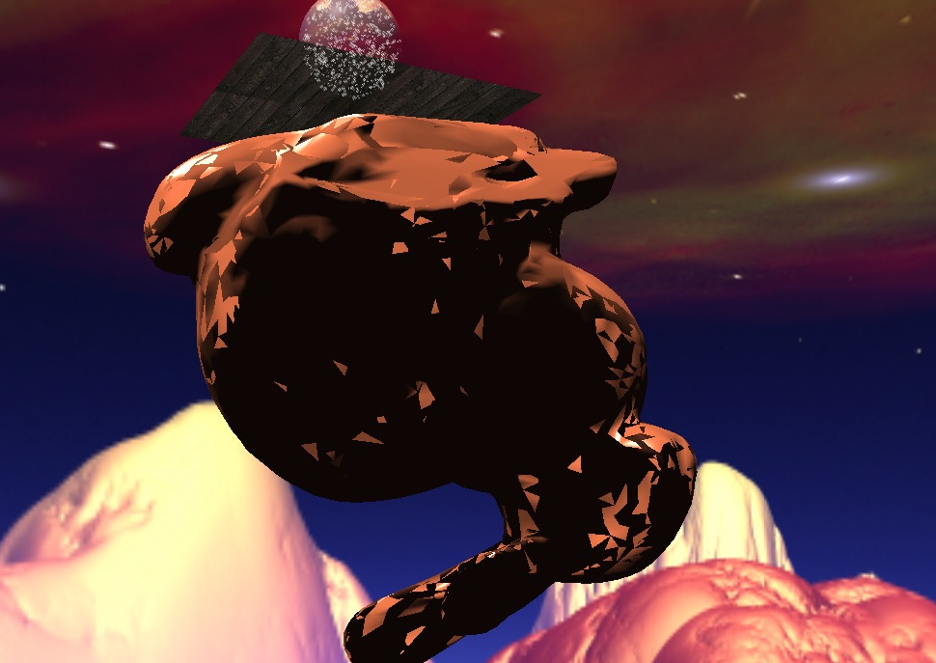
Problem?
Nightmare for
a bunny
Look from the bottom If drawing ground
after drawing the snowflake

Slide 17
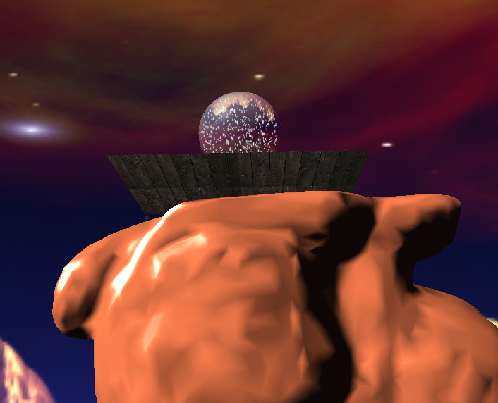
Solution!
Fixed by manually enable and disable depth-test, and draw the objects in certain order.
(disable writing to depth buffer)skybox->glass ball->(disable depth test)snow flake->the base and the floor

Slide 18
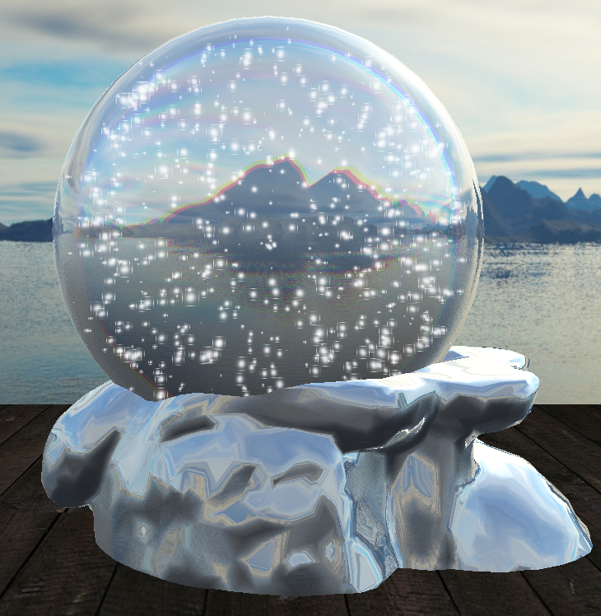
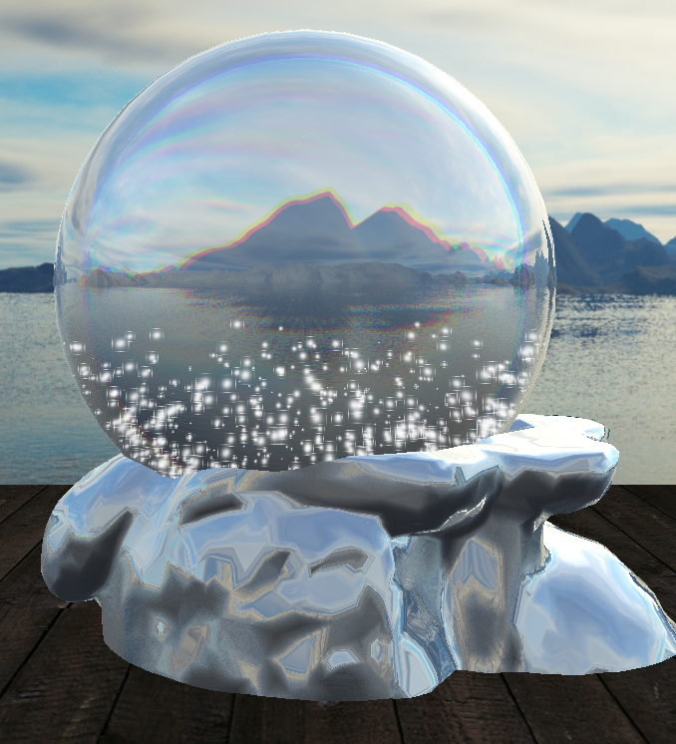
Final results
Press 1 - randomly
Press 2 – falling down

Slide 19
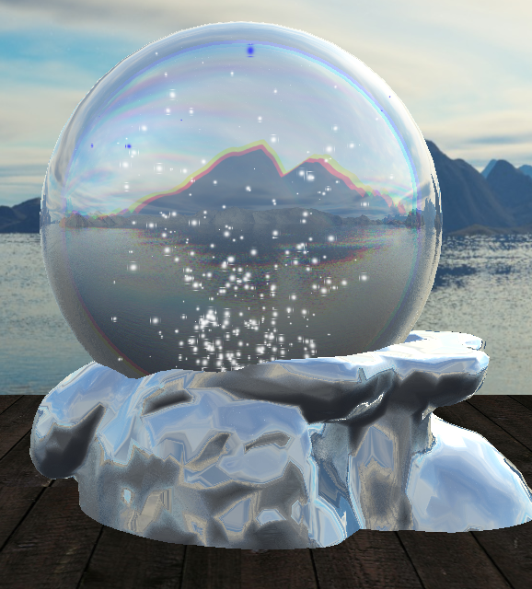
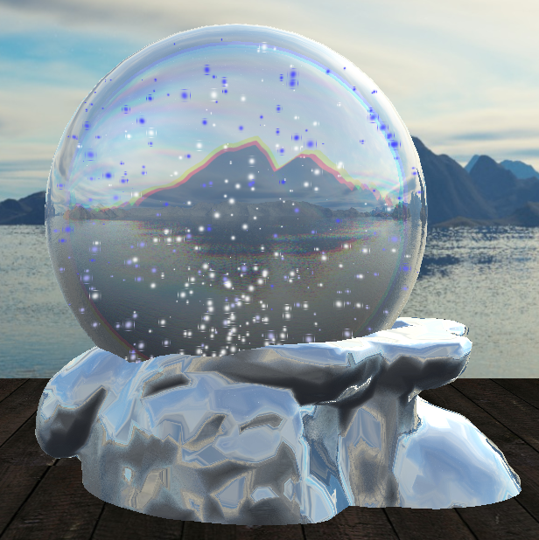
Final results
Press 3 – wind below
Turn to blue if hit the ball

Slide 20
How is it related to cs148
Topics related:
OpenGL (Of course!)
Shaders & Materials
Particle simulation

Slide 21
Q&A
Presented by Boyu LIU, Tianci WANG and Rui YAN
For cs148 @Stanford summer 2016

